Slide 2
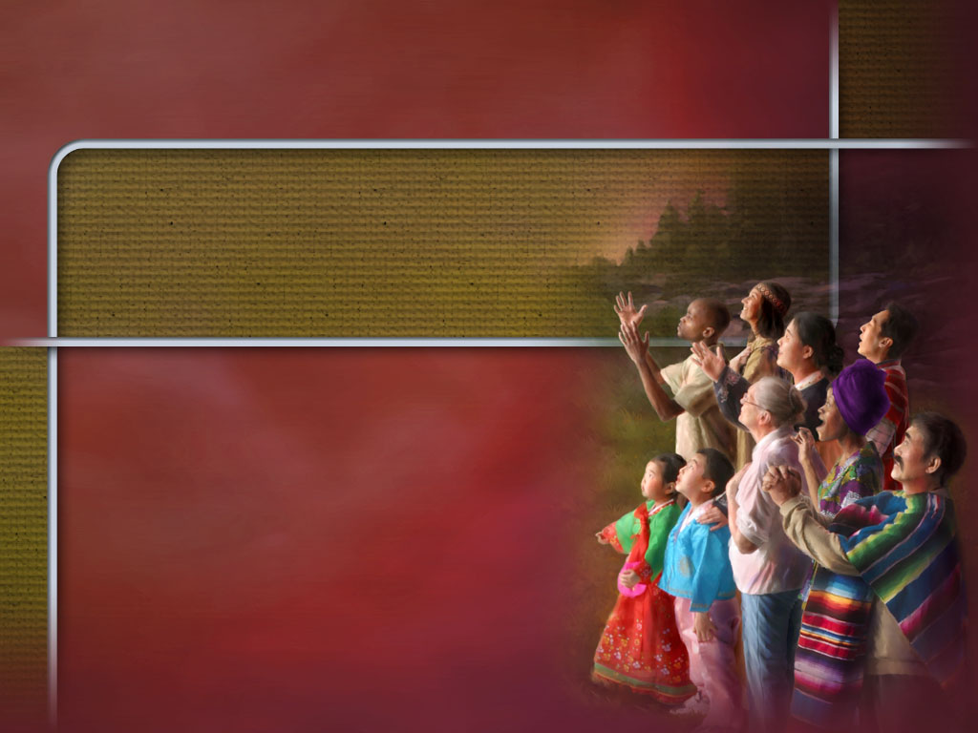
The Hope of Glory
Colossians 1:24-27

Slide 3
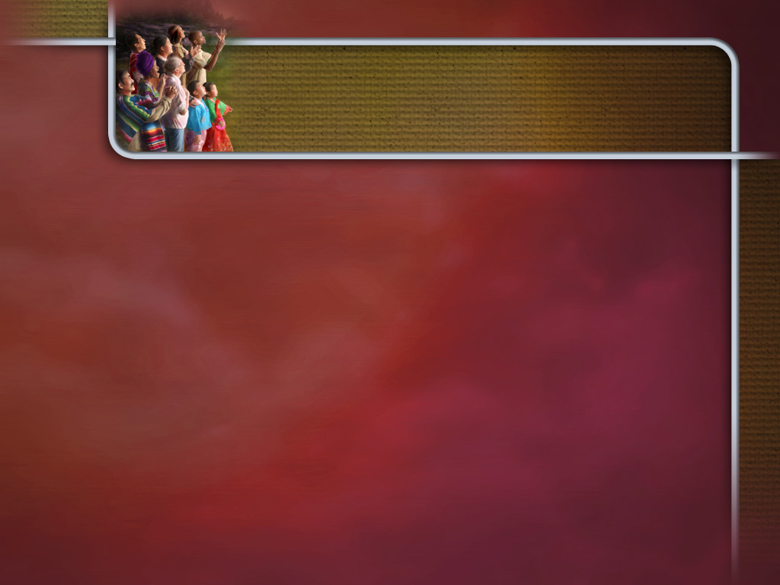
Descriptions
It is a living hope – 1 Peter 1:3.

Slide 4
Descriptions
It is a living hope – 1 Peter 1:3.
It is a blessed hope –Titus 2:13.

Slide 5
Descriptions
It is a living hope – 1 Peter 1:3.
It is a blessed hope –Titus 2:13.
It is a good hope – 2 Thessalonians 2:16-17.

Slide 6
Provides Stability
Hope is referred to as anchor for the soul – Hebrews 6:17-20.

Slide 7
Provides Stability
Hope is referred to as anchor for the soul – Hebrews 6:17-20.
It is anchored in heaven – Colossians 1:3-5; 1 Peter 1:3-4.

Slide 8
Provides Stability
Hope is referred to as anchor for the soul – Hebrews 6:17-20.
It is anchored in heaven – Colossians 1:3-5; 1 Peter 1:3-4.
It provides the confidence we need to persevere and remain faithful – Romans 5:1-5.

Slide 9
Motivates Purity
God expects and requires us to be holy – 1 Peter 1:13-19.

Slide 10
Motivates Purity
God expects and requires us to be holy – 1 Peter 1:13-19.
If we turn back to the world we forfeit our hope – 2 Peter 2:20-22.

Slide 11
Motivates Purity
God expects and requires us to be holy – 1 Peter 1:13-19.
If we turn back to the world we forfeit our hope – 2 Peter 2:20-22.
Therefore our hope motivates us to purify ourselves – 1 John 3:1-3; 2 Corinthians 6:14-7:1.

Slide 12
Inspires Confidence
Through Christ we can have confidence of fellowship with God and eternal life in heaven – Hebrews 10:18-23.

Slide 13
Inspires Confidence
Through Christ we can have confidence of fellowship with God and eternal life in heaven – Hebrews 10:18-23.
God assures us that we do not have to fear His coming – 1 John 4:17-5:3.

Slide 14
Inspires Confidence
Through Christ we can have confidence of fellowship with God and eternal life in heaven – Hebrews 10:18-23.
God assures us that we do not have to fear His coming – 1 John 4:17-5:3.
His promises and assurance inspire us to continue to serve Him – 1 John 5:11-15.

Slide 15
Promotes Rejoicing
Hope itself involves happiness and joy – Romans 5:1-2.

Slide 16
Promotes Rejoicing
Hope itself involves happiness and joy – Romans 5:1-2.
Knowing what God has in store gives us great cause for rejoicing – Romans 8:18-25.

